Slide 1
UPLIFTING FARMERS THROUGH A CONNECTED ECOSYSTEM
PIP104 University Project-II
Review-1
Batch Number: 17
Under the Supervision of,
Ms. Deepthi S
Assistant Professor
School of Computer Science & Engineering
Presidency University
Roll Number | Student Name
20211CAI0111 | Nidhi D
20211CAI0140 | Vignesh V
20211CAI0143 | Sandeep R
20211CAI0149 | Anil Kumar S
Name of the Program: B.Tech
Name of the HoD: Dr. Zafar Ali Khan
Name of the Program Project Coordinator: Dr. Afroz Pasha
Name of the School Project Coordinators: Dr. Sampath A K / Dr. Abdul Khadar A / Mr. Md Ziaur Rahman

Slide 2
Introduction
Agriculture is vital to the Indian economy, supporting millions of farmers. However, farmers face challenges like limited access to financial services, modern equipment, and expert advice.
To address these issues, digital solutions are emerging to transform agriculture.
This project aims to create a mobile app that provides farmers with a connected ecosystem for leasing, retailing and selling produce.
The app will also offer expert advice and streamline supply chains, allowing farmers to sell directly to local markets, reducing intermediaries, and fostering a more efficient, inclusive farming ecosystem.

Slide 3
Literature Review
Sl No. | Reference | Title | Key Findings | Year | Journal/DOI | Conclusion
1. | M.S. Petukhova, Artem Vadimovich Kokorin | Ecosystem Approach to Digitization of the Agricultural Industrial Complex | Smart connected farms enhance production and profitability. Integration of technology and social sciences is essential. | 2024 | Innovacii i prodovolʹstvennaâ bezopasnostʹ, doi: 10.31677/2311-0651-2024-43-1-158-165 | Digital integration in agriculture offers significant productivity gains and improved profitability when combining technological and social approaches.
2. | Yongxiang He, Jinghua Song, Wenjun Ouyang, Qinghua Li | Formation Mechanism and Implementation Path of a Digital Agriculture Innovation Ecosystem | Digital tech fosters a Remote Sensing-Assisted Digital Agriculture Innovation Ecosystem, enhancing accuracy, reliability, and resource access. | 2024 | Tehnicki Vjesnik-Technical Gazette, doi: 10.17559/tv-20231107001080 | Leveraging digital tools can build robust agricultural ecosystems, enhancing resource availability and market access for farmers.

Slide 4
Sl No. | Reference | Title | Key Findings | Year | Journal/DOI | Conclusion
3. | S.A. Vigneshvaran, R. Belgin Jorash, Aakash R.N. | Tech-Infused Agri Revolution: A Holistic Approach to Sustainable Agriculture and Food Security in India | Technology enhances crop management and market access by providing soil health insights and facilitating direct sales. | 2024 | IEEE, doi: 10.1109/adics58448.2024.10533563 | Technological advancements can greatly benefit Indian agriculture by improving crop yield and enabling direct market access.
4. | D.V. Patel, Dr. M.B. Zala, D.R. Chaudhari, Dr. Y.H. Rathwa, Dr. P.G. Gamar, Shobhit Srivastava | Digital Empowerment in Indian Agriculture: Unveiling the ICT Revolution | ICT revolutionizes Indian agriculture, empowering farmers with digital infrastructure and user-friendly applications for sustainable growth. | 2024 | doi: 10.58532/v3bkso13p4ch7 | ICT tools are key for modernizing Indian agriculture, supporting growth and enabling sustainable farming practices.

Slide 5
Sl No. | Reference | Title | Key Findings | Year | Journal/DOI | Conclusion
5. | PS Shehrawat, Arulmanikandan B., Aditya Sandeep, Bhakar | Exploring Awareness and Utilization of Agricultural Mobile Apps among Smallholder Farmers. | Low awareness/utilization of agricultural apps, which provide weather, market, and pest data | 2024 | International Journal of Agriculture Extension and Social Development, doi: 10.33545/26180723.2024.v7.i1d.217 | Increasing awareness of agricultural apps can help farmers access critical data and improve farm management.
6. | Yongxiang He, Jinghua Song, Wenjun Ouyang, Qinghua Li | Formation Mechanism and Implementation Path of a Digital Agriculture Innovation Ecosystem | Digital tech fosters a Remote Sensing-Assisted Digital Agriculture Innovation Ecosystem, enhancing accuracy, reliability, and resource access. | 2024 | Tehnicki Vjesnik-Technical Gazette, doi: 10.17559/tv-20231107001080 | Leveraging digital tools can build robust agricultural ecosystems, enhancing resource availability and market access for farmers.

Slide 6
Sl No. | Reference | Title | Key Findings | Year | Journal/DOI | Conclusion
7. | Dinesh Kumar Chauhan | Innovative Solutions for Agri-Food: Transforming Agriculture through Digital Technologies | Focus on digital tech for small farmers, exploring challenges and solutions for implementing digital technologies. | 2023 | International Journal of Advanced Scientific Research and Management, doi: 10.36282/ijasrm/8.1.2023.1888 | Small farmers face unique challenges in adopting digital tech, but solutions tailored to their needs can drive sustainable agriculture.
8. | Lilei Zhou, Dongjie Guan, Lingli Sun, Xiujuan He, Maolin Chen, Yongchuan Zhang, Lianjie Zhou | What is the Relationship between Ecosystem Services and Farmers’ Livelihoods? Based on Measuring the Contribution of Ecosystem Services to Farmers’ Livelihoods | Ecosystem services significantly impact farmers' livelihoods. Varying contributions to ecosystem services-related income by farming household type. | 2023 | Frontiers in Ecology and Evolution, doi: 10.3389/fevo.2023.1106167 | The interconnection between ecosystem services and farmer livelihoods highlights the need for diverse strategies tailored to household types to maximize sustainability.

Slide 7
Sl No. | Reference | Title | Key Findings | Year | Journal/DOI | Conclusion
9. | M. Kumar, Ms. Y. Sahithi, Ms. Nikhat Sheerin, Ms. T. Aakanksha, Mr. K. Rajkumar Reddy | Uplifting the Farmer through Connected Ecosystems | New approaches improve farmers' understanding of practices. System addresses data gaps for better farming decisions. | 2022 | Ymer, doi: 10.37896/ymer21.04/54 | Connected ecosystems can empower farmers by closing data gaps and improving decision-making, leading to more informed farming practices.
10. | Johanna Björklund, Hailu Araya, Susan Edwards, Andre Goncalves, Karin Hook, Jakob Lundberg, Charito Medina | Ecosystem-Based Agriculture Combining Production and Conservation—A Viable Way to Feed the World in the Long Term? | Ecosystem-based agriculture improves livelihoods and ecosystem services. Local knowledge and collective action are crucial. | 2012 | Journal of Sustainable Agriculture, doi: 10.1080/10440046.2012.705813 | Integrating conservation into agricultural practices through ecosystem-based approaches can sustainably improve food security.

Slide 8
Existing method Drawback
Dependency on Middlemen: Middlemen can exploit farmers by offering lower prices for crops while selling them at much higher rates in markets, leading to decreased income for the farmers.
Lack of Direct Access to Markets: This limits their ability to sell at competitive prices and reduces their bargaining power, increasing their reliance on middlemen.
Fragmented Information and Lack of Expert Advice: This leads to suboptimal farming practices, lower crop yields, and inefficient use of resources like water and fertilizers.

Slide 9
Proposed Method
Centralized Mobile Application for Farmers: Farmers can manage every aspect of their business from a single platform, which reduces the need for middlemen and provides direct access to markets, financial services, and agricultural resources.
Access to Digital Marketplaces and Elimination of Middlemen: Farmers get better prices for their produce and are not subject to the exploitation often seen when working through middlemen.
Real-Time Expert Advice: Farmers receive timely guidance tailored to their specific farming needs, improving crop yields and promoting sustainability.

Slide 10
Objectives
To Develop a User-Friendly Mobile Application for Farmers with Integrated Services
To Establish a Centralized Platform for Connecting Farmers with Local Experts and Resources
To Improve Access to Marketplaces for Selling Agricultural Produce

Slide 11
Methodology
Problem Identification : Identify key challenges farmers face, such as limited access to financial services, equipment, and expert advice.
Mobile App Development : Develop a user-friendly mobile application using Android Studio and Java. The app will provide a one-stop solution for farmers to manage retailing, leasing, selling, and expert consultation.
Backend Development : Set up a cloud server using Node.js and Express.js to handle user requests, data processing, and storage using MongoDB. Ensure real-time synchronization using Firebase.

Slide 12
Testing Under Real-World Conditions : Test the app's performance on Android smartphones under various network conditions to ensure functionality in rural areas with poor connectivity.
Integration of Features : Implement features like access to local vendors, marketplaces and real-time expert advice.
Launch and Feedback Collection : Deploy the app, gather feedback from farmers, and optimize the app based on their needs and suggestions.

Slide 13
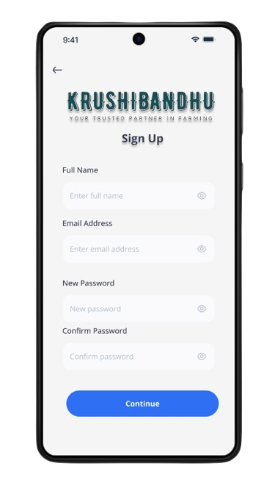
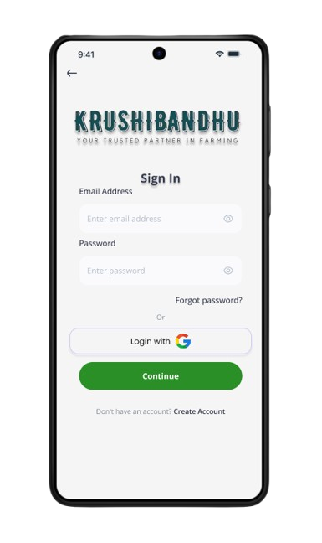
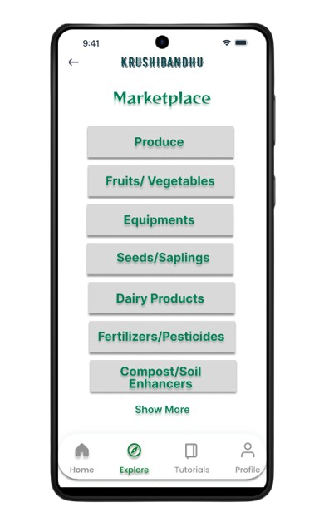
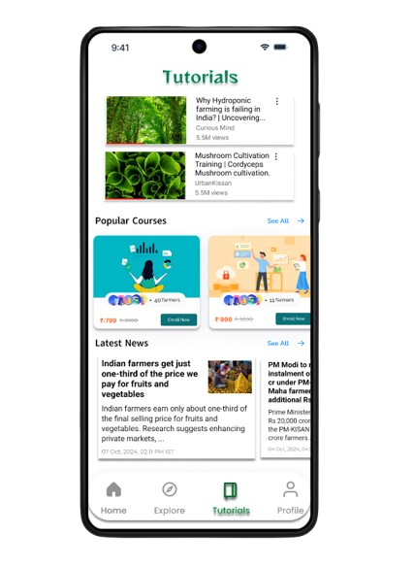
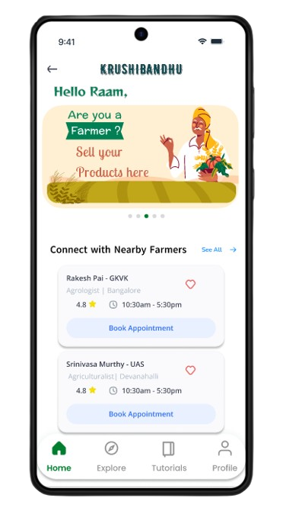
Architecture

Slide 14
Hardware Components
Android Smartphones:
Devices for farmers to interact with the mobile application, access market data, communicate with experts, and manage transactions.
Cloud Servers:
To host the backend application, database, and API services, ensuring scalability, performance, and reliability.
Network Infrastructure (Routers, Mobile Data):
Required to test app performance under varying network conditions like Wi-Fi, mobile data, or low connectivity in rural areas.

Slide 15
Software Components
Android Studio: The primary Integrated Development Environment (IDE) used to develop the Android mobile application. It provides tools for designing the user interface, writing Java code, and debugging the app.
Java: Used to build the core functionalities of the Android application, including user interfaces, interactions, and backend API calls.
Node.js with Express.js: Node.js, with the Express.js framework, is used to develop the server-side logic of the application, handle REST API requests, and communicate with the database.

Slide 16
MongoDB: MongoDB is used to store user data, agricultural information, marketplace details, and transaction records.
Firebase: Firebase is used for real-time database synchronization, user authentication, and cloud storage.
GitHub: For managing the source code, collaborating among team members, and maintaining version control.

Slide 17
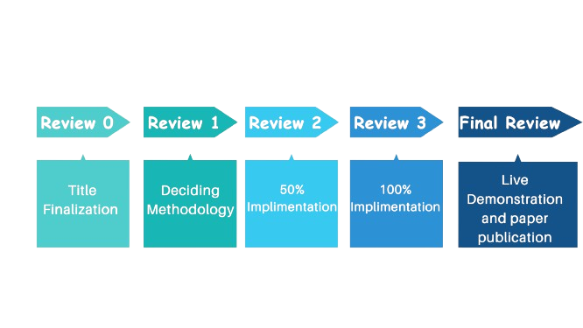
Timeline of Project

Slide 18
Expected Outcomes
Improved Access to Agricultural Resources
Real-Time Expert Advice and Data
Enhanced Market Linkages
User-Friendly Platform with Broader Adoption

Slide 19
Conclusion
The "Uplifting Farmers Through a Connected Ecosystem" project showcases how technology can transform agriculture by addressing farmers' needs for information, resources, and support. The mobile app developed provides a platform for accessing vendors, leasing machinery, managing agri-credit, receiving expert advice, and selling products.
Using technologies like Firebase and cloud services, the app offers a user-friendly solution for rural farmers. Continuous feedback ensures it remains relevant and scalable. Successful deployment will boost farm productivity, improve economic outcomes, and promote sustainable practices, advancing a smarter, more connected farming ecosystem.

Slide 20
References
[1] M., S., Petukhova., Artem, Vadimovich, Kokorin. (2024). 1. Ecosystem approach то digitization of the agricultural industrial complex. Innovacii i prodovolʹstvennaâ bezopasnostʹ, doi: 10.31677/2311-0651-2024-43-1-158-165
[2] Yongxiang, He., Jinghua, Song., Wenjun, Ouyang., Qinghua, Li. (2024). 3. Formation Mechanism and Implementation Path of a Digital Agriculture Innovation Ecosystem. Tehnicki Vjesnik-technical Gazette, doi: 10.17559/tv-20231107001080
[3] S., A., Vigneshvaran, R., Belgin, Jorash., Aakash, R., N., M. (2024). 1. Tech-Infused Agri Revolution: A Holistic Approach to Sustainable Agriculture and Food Security in India. doi: 10.1109/adics58448.2024.10533563
[4] D., V., Patel., Dr, M.B., Zala., D., R., Chaudhari., Dr, Y.H., Rathwa., Dr, P., G., Gamar., Shobhit, Srivastava. (2024). 4. Digital empowerment in indian agriculture: unveiling the ict revolution. doi: 10.58532/v3bkso13p4ch7

Slide 21
[5] PS, Shehrawat., Arulmanikandan, B., Aditya., Sandeep, Bhakar. (2024). 1. Exploring awareness and utilization of agricultural mobile apps among smallholder farmers. International journal of agriculture extension and social development, doi: 10.33545/26180723.2024.v7.i1d.217
[6] Soham, Adla., Ashray, Tyagi., Aiswarya, Aravindakshan., Ramesh, Guntha., Mario, Alberto, Ponce, Pacheco., Anukool, Nagi., Prashant, Pastore., Saket, Pande. (2024). 1. Participatory development of mobile agricultural advisory driven by behavioral determinants of adoption. doi: 10.5194/egusphere-egu24-8858
[7] Dinesh, Kumar, Chauhan. (2023). 10. Innovative Solutions for Agri-Food: Transforming Agriculture through Digital Technologies. International journal of advanced scientific research and management, doi: 10.36282/ijasrm/8.1.2023.1888

Slide 22
[8] Lilei, Zhou., Dongjie, Guan., Lingli, Sun., Xiujuan, He., Maolin, Chen., Yongchuan, Zhang., Lianjie, Zhou. (2023). 5. What is the relationship between ecosystem services and farmers’ livelihoods? Based on measuring the contribution of ecosystem services to farmers’ livelihoods. Frontiers in Ecology and Evolution, doi: 10.3389/fevo.2023.1106167
[9] M., M., Kumar., Ms., Y, Sahithi., Ms., Nikhat, Sheerin., Ms., T, Aakanksha., Mr., K, Rajkumar, Reddy. (2022). 1. Uplifting the farmer through connected ecosystems. Ymer, doi: 10.37896/ymer21.04/54
[10] Johanna, Björklund., Hailu, Araya., Susan, Edwards., Andre, Goncalves., Karin, Hook., Jakob, Lundberg., Charito, Medina. (2012). 7. Ecosystem-Based Agriculture Combining Production and Conservation—A Viable Way to Feed the World in the Long Term?. Journal of Sustainable Agriculture, doi: 10.1080/10440046.2012.705813

Slide 23
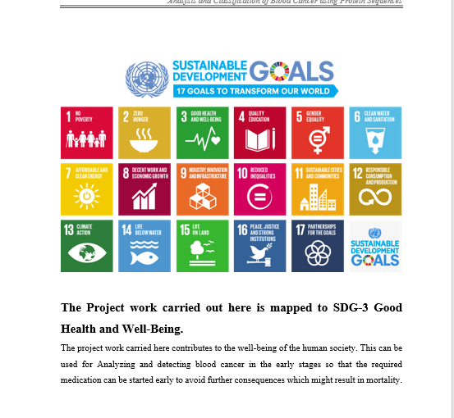
Project work mapping with SDG
SDG 8: Decent Work and Economic Growth
SDG 9: Industry, Innovation, and Infrastructure
SDG 12: Responsible Consumption and Production
SDG 17: Partnerships for the Goals

Slide 24
Github Link
https://github.com/VigneshVeb/Farmer-App.git

Slide 25
Thank You

